Slide 1
20767C
Implementing a SQL Data Warehouse

Slide 2

Welcome!
Thank you for joining us today.
We’ve worked together with Microsoft Learning Partners and Microsoft IT Academies to bring you a world-class learning experience, including:
Microsoft Certified Trainers + Instructors. Your instructor is a premier technical and instructional expert who meets ongoing certification requirements.
Customer Satisfaction Guarantee. Our Partners offer a satisfaction guarantee and we hold them accountable for it. At the end of class, please complete an evaluation of
today’s experience. We value your feedback!
Certification Benefits. After training, consider pursuing a Microsoft Certification, to help distinguish your technical expertise and experience. Ask your instructor about available exam promotions and discounts.
We wish you a great learning experience and ongoing career success!

Slide 3
Hello
Instructor: <Instructor Name>
<Title or other credentials, e.g. Microsoft Certified Trainer>
<Affiliation/Company>
<A few words about my technical and professional experience>
Notes:
Fill in the information on this slide and provide your own details.

Slide 4
Student Introductions
Name
Company affiliation
Title/function
Job responsibility
Business Intelligence experience
Your expectations for the course

Slide 5
Facilities
Class hours
Building hours
Parking
Restrooms
Meals
Phones
Messages
Smoking
Recycling

Slide 6
About This Course
Audience
Course Prerequisites
Course Objectives
What You Can Expect
Notes:
Audience
The primary audience for this course is database and BI professionals who are familiar with data warehouses and enterprise BI solutions that are built by using Microsoft SQL Server® technologies.
Student Prerequisites
In addition to their professional experience, students who attend this training should already have the following technical knowledge:
Some knowledge of data warehousing and data modeling principles.
Familiarity with Excel and SharePoint Server 2013.

Slide 7
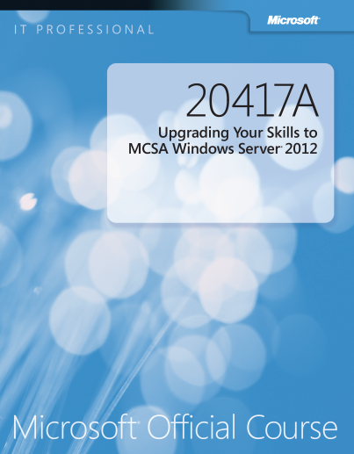
Your Course Materials
Designed to optimize your classroom learning experience.
And support you back on the job.
Microsoft Official Course Handbook
Organized by Modules
Includes Labs + Lab Answer Keys
Module Reviews + Takeaways—great for on-the-job reference

Slide 8
Course Outline
Module 1, “Introduction to Data Warehousing"
Module 2, “Planning Data Warehouse Infrastructure"
Module 3, “Designing and Implementing a Data Warehouse "
Module 4, “Columnstore Indexes"
Module 5, “Implementing an Azure SQL Data Warehouse"
Module 6, “Creating an ETL Solution"
Module 7, “Implementing Control Flow in an SSIS Package"
Module 8, “Debugging and Troubleshooting SSIS Packages"
Module 9, “Implementing a Data Extraction Solution"
Module 10, “Enforcing Data Quality"
Module 11, “Master Data Services"
Module 12, “Extending SQL Server Integration Services"
Module 13, “Deploying and Configuring SSIS Packages"
Module 14, “Consuming Data in a Data Warehouse"

Slide 9
Related Courses
20761C: Querying Data with Transact-SQL
20762C: Developing SQL Databases
20764C: Administering a SQL Database Infrastructure
20765C: Provisioning SQL Databases
20767C: Implementing a SQL Data Warehouse
20768C: Developing SQL Data Models
10985C: Introduction to SQL Databases
10986C: Updating Your Skills to SQL Server 2016
10987C: Performance Tuning and Optimizing SQL databases
10988C: Managing SQL Business Intelligence Operations
10989C: Analyzing Data with and PowerBI
10990C: Analyzing Data with SQL Server Reporting Services
See the full line of Microsoft Training and Certification resources at: http://www.microsoft.com/learning/

Slide 10
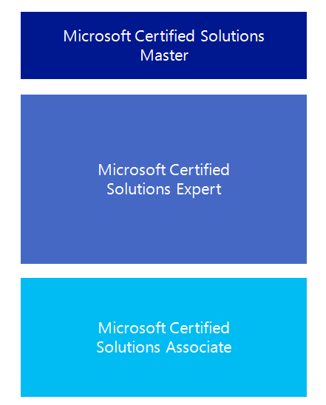

Microsoft Certification Program
Get trained. Get certified.
Get ahead.
Microsoft Certifications demonstrate you have the skills to design, deploy, and optimize the latest technology solutions.
Ask your Microsoft Learning Partner how you can prepare for certification.
Also see:
http://www.microsoft.com/learning/
certification

Slide 11

Preparing for the Labs
Your lab activities will be centered around Adventure Works Cycles, a fictitious manufacturer and seller of cycles and related products.
To complete the labs, you will work in a virtual machine (VM) environment.

Slide 12






Virtual Machine Environment
Virtual Machine Name: | Use as:
20767C-MIA-DC | Domain controller
20767C-MIA-SQL | Database and BI server
MSL-TMG1 | Internet gateway
MIA-DC
Internet
MIA-SQL
ADVENTUREWORKS.MSFT
MSL-TMG1
Notes:
All modules use the same virtual machines for the labs. The lab files are located in the D:\Labfiles folder, in subfolders named Lab01, Lab02, and so on. The demonstration files are located in the D:\Demofiles folder in subfolders named Mod01, Mod02, and so on.
For all labs, students should log on as ADVENTUREWORKS\Student with the password Pa$$w0rd.
Each lab includes a Setup.cmd script to reset the lab environment, so there is no need for students to revert the virtual machines to a previous snapshot between labs. However, it is recommended that students take a snapshot of both virtual machines during the following demonstration, so that if necessary, they can revert to a clean starting environment.

Slide 13
Demonstration: Using Hyper-V Manager
In this demonstration, you will learn how to:
Open Hyper-V Manager
Navigate the various sections/panes within Hyper-V Manager
Virtual Machines, Snapshots, and Actions: Server-specific and VM-specific
Identify the VMs used in the labs for this course
Take a Snapshot and Apply a Snapshot
Connect to a VM
Start and log on to a VM
Switch between full screen and window modes
Revert to the previous Snapshot
Shut down a VM
When to use Shut Down or Turn off
Close Hyper-V Manager

